Slide 1
Algorithm Research on User Interests Extracting via Web Log Data

Slide 2
Abstract
The information on the web is growing dramatically. Without a recommendation system, the users may spend lots of time on the web in finding the information they are interested in.
Today, many web recommendation systems can not give users enough personalized help but provide the user with lots of irrelevant information. One of the main reasons is that it can't accurately extract user's interests.
Therefore, analyzing users' Web Log Data and extracting users' potential interested domains become very important and challenging research topics of web usage mining. If users' interests can be automatically detected from users' Web Log Data, they can be used for information recommendation and marketing which are useful for both users and Web site developers.

Slide 3
Introduction
In the early studies on personalized service, user's interest modeling techniques were not paid much attention to as what they are deserved. An amount of researches focused on personalized service to achieve the specific technology, such as the recommended technology, information retrieval, user clustering technology, but user modeling techniques are rarely mentioned.
However, researchers gradually realize that the quality of personalized service not only depends on the specific recommendation technology, search technology, but also relies on user's preferences and other characteristics of interest, description of its computable, while the latter is particularly important.

Slide 4
Introduction
Many web personalization systems have been built based on different approaches [7, 8, 9]. No matter what kind of approach they use, their data can be divided into two categories: usage data (the user's navigational behavior) and the user's profile data.
Based on mining these data, the existing systems give the user a list of web pages that he or she might be interested in. None of them give the user a list of interested domains. The reason is interests extracting models of these systems only extract a list of web pages that the user is interested in, but don't extract a list of interested domains.

Slide 5
Introduction
Our approaches are unique and different from the existing studies from the following aspects:
(1) The algorithms are unique and novel, they are based on lasting time of the visit behaviors of a domain and the visit density to judge whether the domain (category) is an interest. This idea, in accordance with the logic, is simple and effective.
(2) It not only extracts a list of web pages the user interested in, but also mines a list of interested domains, including Long Term Interests and Short Term Interests.

Slide 6
Introduction
(3) Pretreatment is very important for extracting. It uses web mining and text mining technologies to preprocess the original Web Log data, laying a good foundation for extracting, and uses vector model of weighted keywords to express user's interest. The keywords are the domains (categories) of the information on the web pages which are acquired by classify technologies but not cluster.

Slide 7
Main Step
Firstly, pretreate the original Web Log Data.
Secondly, extract user's Long Term Interests and Short Term Interests based on visit time and visit density which can be obtained from an analysis of RwCs (records with category) generated from Web Log Data.

Slide 8
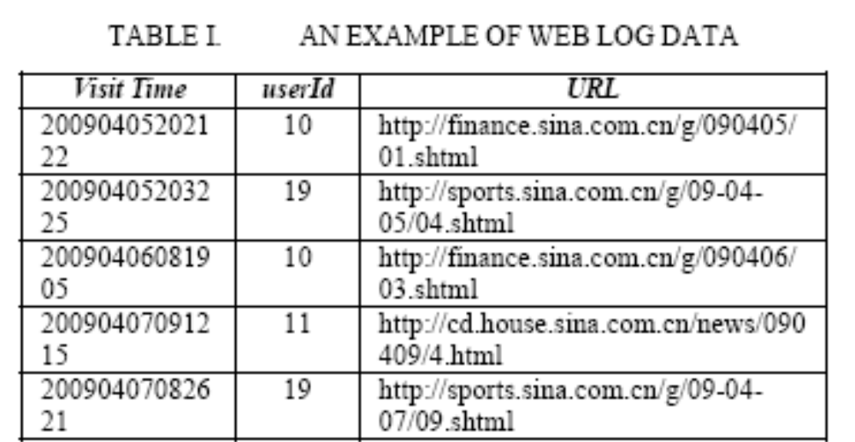
Original Web Log Data Pretreatment Process
A. Original Web Log Data
  Web Log Data is a kind of data that records users' web watching behaviors (such as visited URL, time of the visit and so on). An example of Web Log Data is shown in TABLEⅠ.

Slide 9
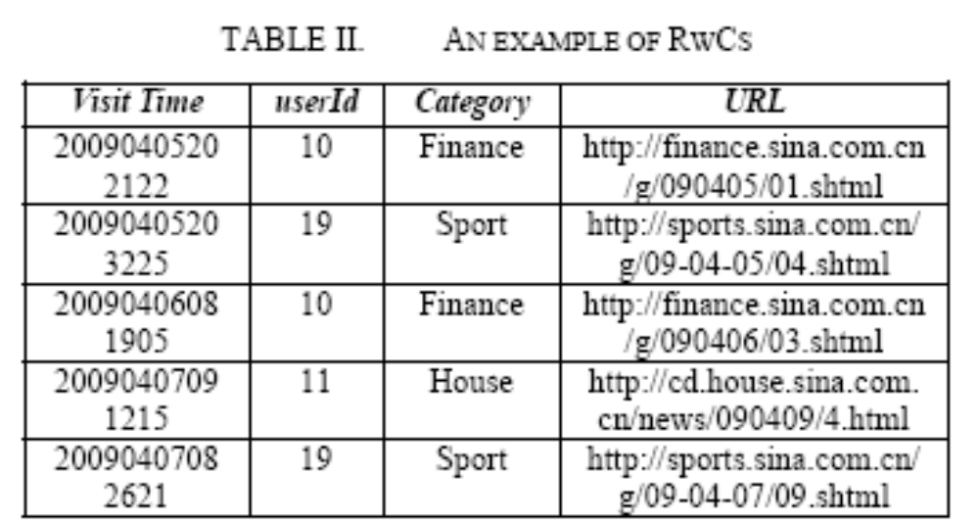
B. RwCs (Records with Categories)
  The key to obtain RwCs is to get categories of web pages. Pretreatment process contains following steps:
  (1) Extract webpage texts of visited URLs. (2) Text segmentation. (3) Feature selection. (4) Classify texts using data mining technologies, such as Support Vectors [10], Decision Tree [11], Neural Network [12], and Bayesian [13] and so on.

Slide 10
Algorithms of Extracting a User’s Interests From RWCs
A user's Web Log Data recorded for one or two years are used to generate RwCs. His or her interests are extracted from RwCs in the following steps:
(1) Extract a user's Long Term Interests.
(2) Mine a user's Short Term Interests.
(3) Compute Interest degree of every interest category.

Slide 11
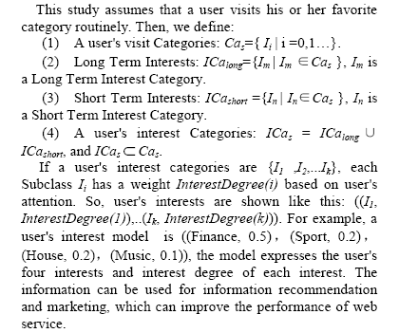
A. Expression of user's interests

Slide 12
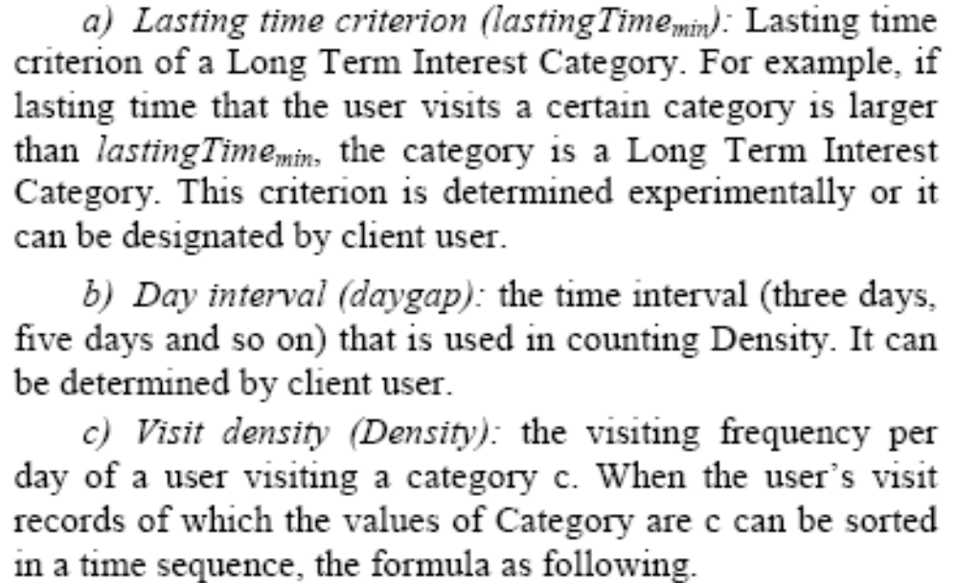
B. Long Term Interests Extracting
1) Definitions and Criteria:

Slide 13
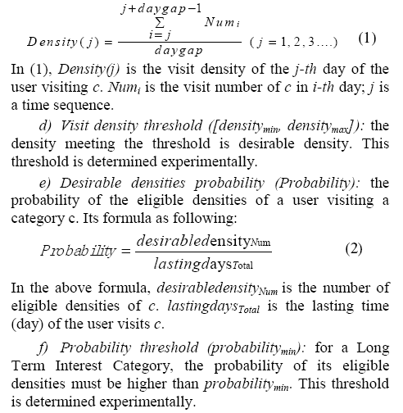

Slide 14
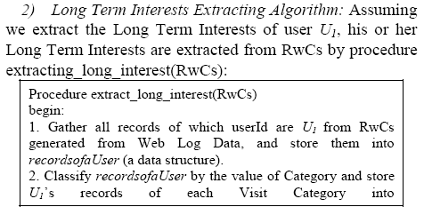
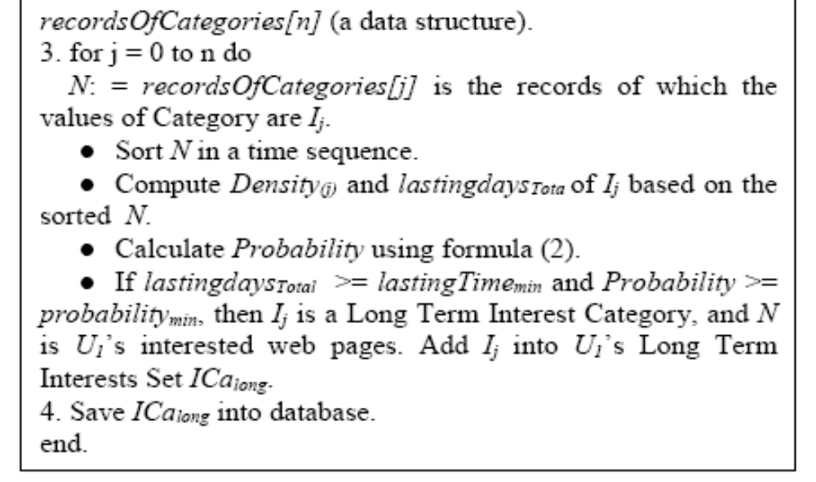

Slide 15
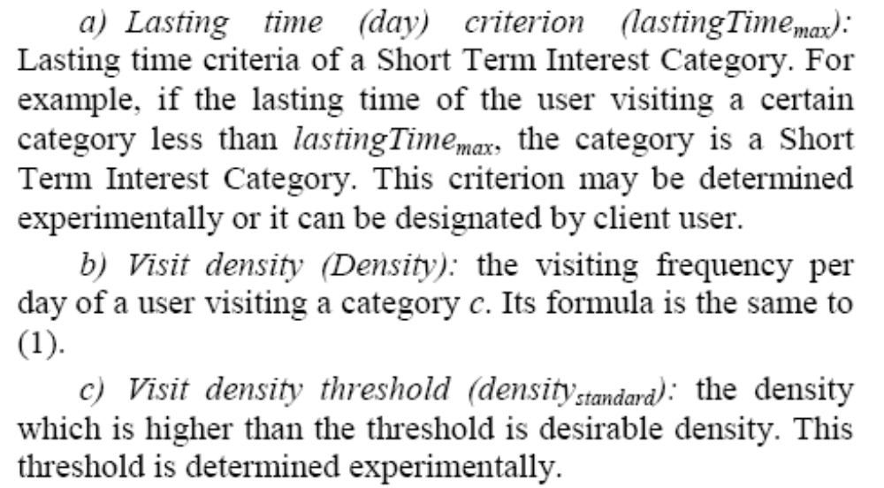
C. Short Term Interests Extracting
1) Definitions and Criteria:

Slide 16
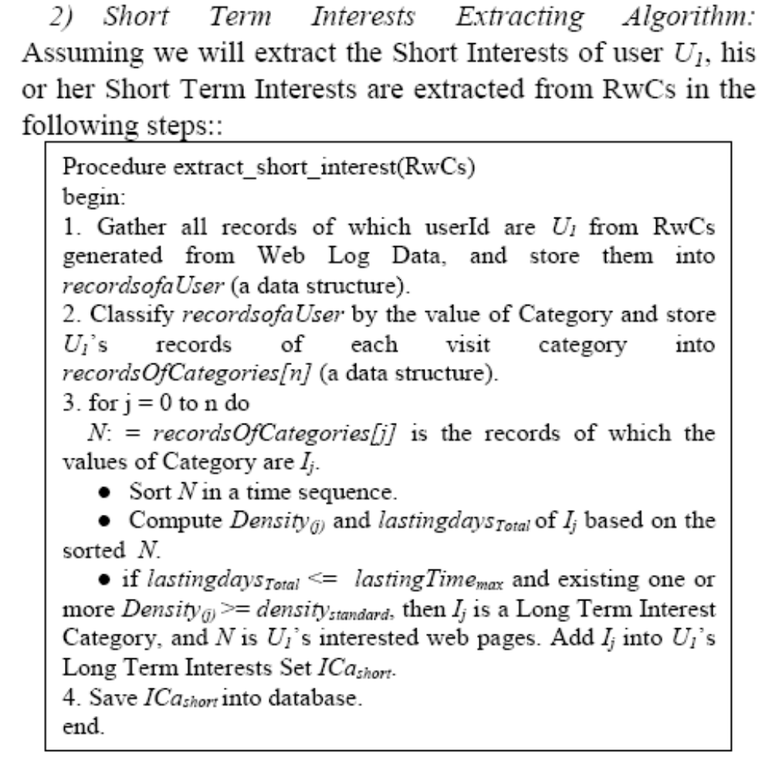

Slide 17
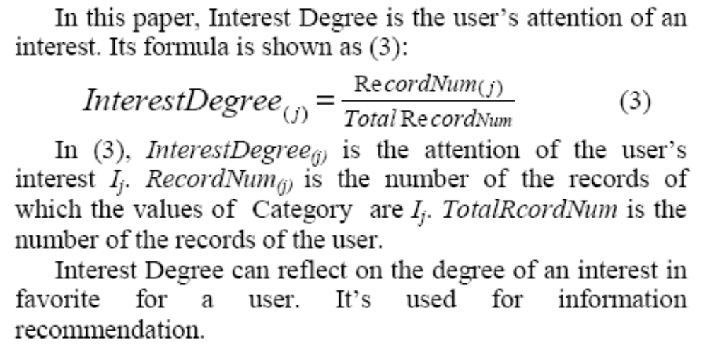
D. Interest Degree

Slide 18
Experiments
As the criteria for evaluating the qualities of selected interests, in order to extract Long Term Interests during the 40 days, the values of the parameters are as follows: lastingTimemin = 25 (days), which is about 3/5 of total days, [densitymin, densitymax] = [0.2, ∞], probabilitymin = 0.75, daygap = 5(days); And to extract Short Term Interests, lastingTimemax = 15(days), which is about 1/3 of total days (40), densitystandard = 1. The above thresholds are determined experimentally. Interests which are meeting the criteria above are regarded as good. Manual inspection of more than 7,000 users' interests is not an easy task. The above criteria are introduced for the purpose of judging the qualities of extracted interstates mechanically.

Slide 19
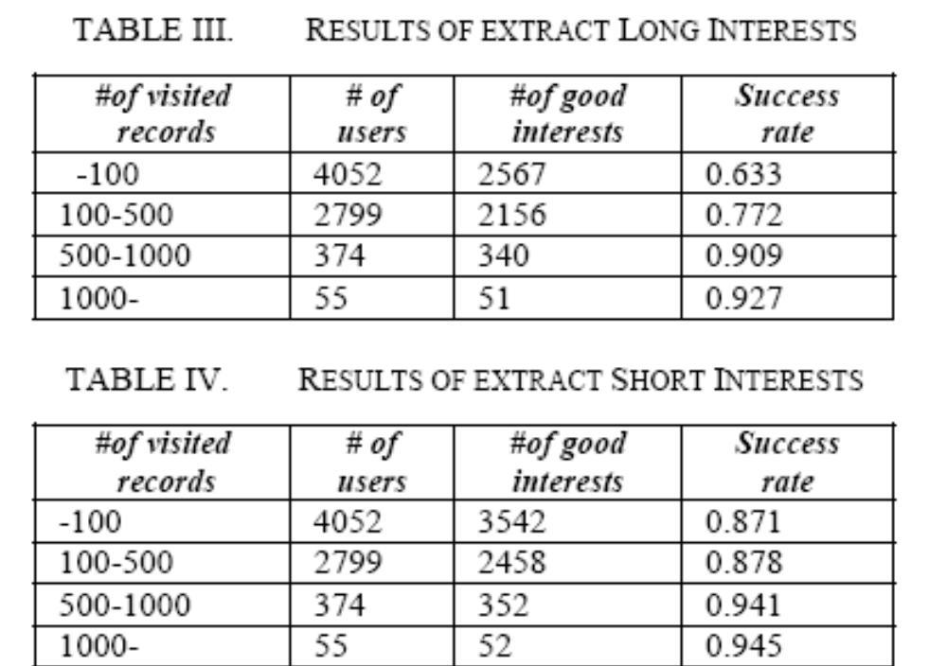

Slide 20
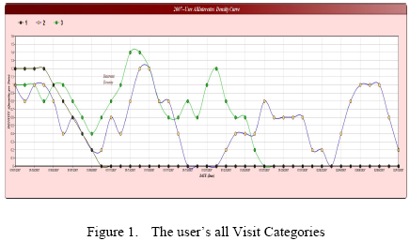
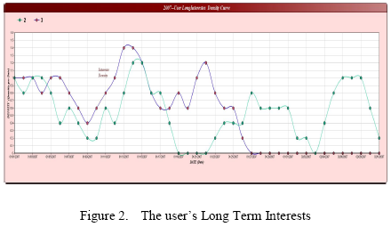
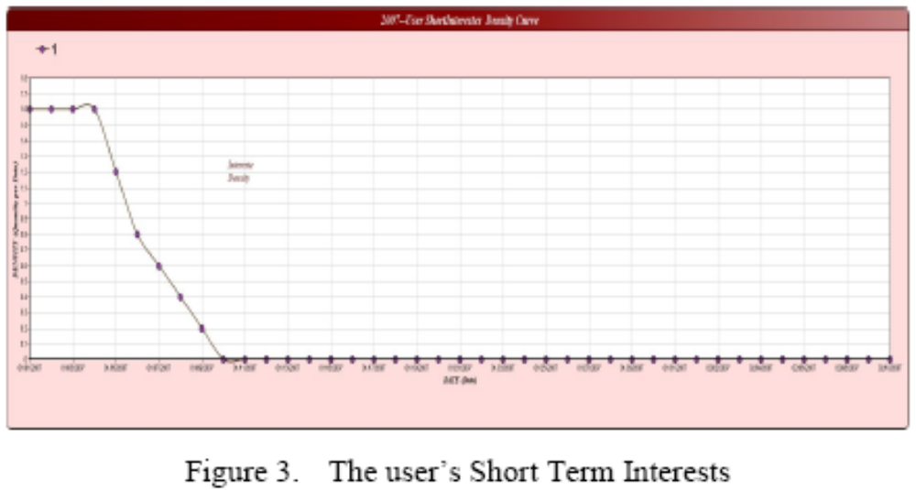

Slide 21
Thanks~

